Slide 1
Lecture 27
Semaphores II
National University of
Computer & Emerging Sciences

Slide 2
Semaphore
Semaphore S – integer variable, stored in the kernel, shared by processes
Two standard operations modify S: wait() and signal()
  Originally called P() and V()
Less complicated
Can only be accessed via two indivisible (atomic) operations
  wait () / P() {
  while S <= 0; // no-op
  S--;
  }
  An atomic operation that waits for semaphore to become positive
  then decrements it by 1
Atomic
Atomic
  signal () / V() {
  S++;
  }
  An atomic operation that increments semaphore by 1; wakes up a waiting P, if any

Slide 3
Two uses of Semaphores
Mutual exclusion
  When semaphores are used for mutual exclusion: “One process in Critical Section”

Slide 4
Two uses of Semaphores
Scheduling constraints
  “When a Process is dependent on another process”
  Semaphores provide a way for a thread to wait for something.
Semaphore S =0
P2
-
-
Wait(S)
S2
-
-
P1
-
-
S1
Signal(S)
-
Notes:
S1 in P1 executes first and S2 in p2 execute after S1 executed. This is dependency constraint as p2 is dependent on P1. we can solve it by calling signal(S) after S1 in p1 and Wait(S) before S2 in p2.

Slide 5
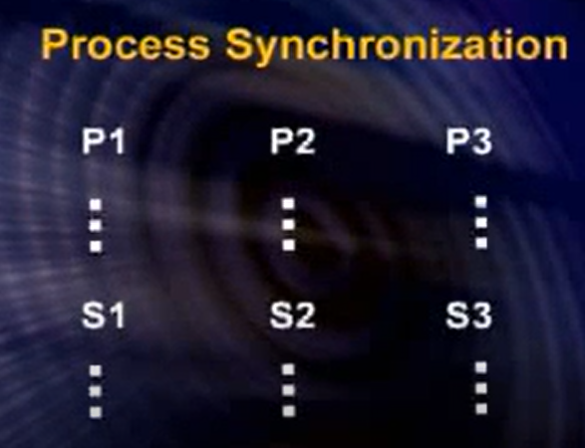
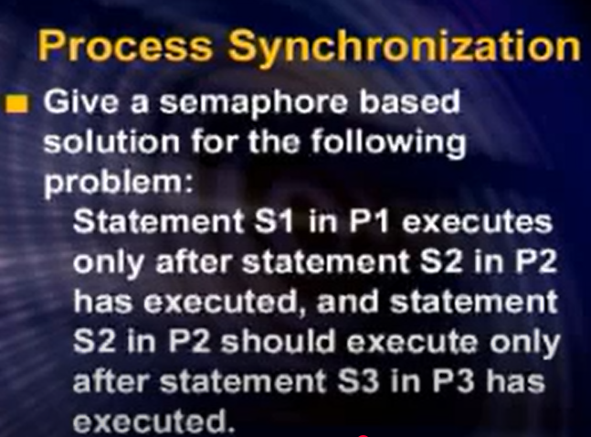
Scheduling Constraint

Slide 6

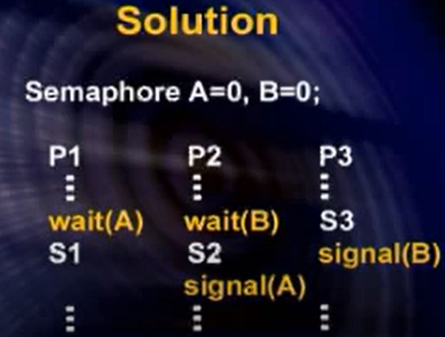
Solution- Scheudling Constraint

Slide 7
Binary and Counting Semaphores
There are two kinds of Semaphores:
  Binary semaphores
    Control access to a single resource, taking the value of 0 (resource is in use) or 1 (resource is available).
  Counting semaphores
    Control access to multiple resources, thus assuming a range of nonnegative values.

Slide 8



The Producer/Consumer Problem
Also called the Bounded Buffer problem.
Producer pushes items into the buffer.
Consumer pulls items from the buffer.
Mmmm... donuts
Producer
Consumer
Notes:
18/02/08

Slide 9

The Producer/Consumer Problem
Also called the Bounded Buffer problem.
Producer pushes items into the buffer.
Consumer pulls items from the buffer.
Producer needs to wait when buffer is full.
Consumer needs to wait when the buffer is empty.
zzzzz....
Producer
Consumer
Notes:
18/02/08

Slide 10
Producer/Consumer Problem
Consumer must wait for producer to fill buffers, if none full
  (scheduling constraint)
Producer must wait for consumer to empty buffers, if all full
  (scheduling constraint)
Only one thread can manipulate buffer queue at a time
  (mutual exclusion)
Use a separate semaphore for each constraint

Slide 11
Producer/Consumer using Sleep/Wakeup
Count keeps track of the number of items in the buffer
n = maximum items in the buffer
The producer checks against n.
  If count == n
    then the producer sleeps
  Else
    Adds the item to the buffer and increments count.
When the consumer retrieves an item from the buffer
  If count == 0
    then the consumer sleeps
  Else
    Removes an item from the buffer and decrements count.

Slide 12
Producer/Consumer using Sleep/Wakeup
Calls to WAKEUP occur under the following conditions.
The producer
  Adds an item to the buffer
  Incremented count.
  if count = 1 (i.e. the buffer was empty before).
    wakes up the consumer.
The consumer
  Removes an item from the buffer
  Decrements count.
  if count == n-1 (i.e. the buffer was full)
    Wakes up the producer.

Slide 13
int BUFFER_SIZE = 100; int count = 0;
void producer(void) { int item;
while(TRUE) {
produce_item(&item);
if(count == BUFFER_SIZE)
sleep ();
enter_item(item);
count++;
if(count == 1)
wakeup(consumer);
}}
void consumer(void) { int item;
while(TRUE) {
if(count == 0)
sleep ();
remove_item(&item);
count--;
if(count == BUFFER_SIZE - 1)
wakeup(producer);
consume_item(&item);
}}

Slide 14
void producer(void) { int item;
while(TRUE) {
produce_item(&item);
if(count == 3)
sleep ();
enter_item(item);
void producer(void) { int item;
while(TRUE) {
produce_item(&item);
if(count == 3)
sleep ();
enter_item(item);
void producer(void) { int item;
while(TRUE) {
produce_item(&item);
if(count == 3)
sleep ();
void producer(void) { int item;
while(TRUE) {
produce_item(&item);
if(count == 3)
sleep ();
enter_item(item);
Count = 0
Count = 1
Count = 2
Count = 3
Producer is Sleeping Now
count++;
count++;
count++;
if(count == 1)
wakeup(consumer); }}
if(count == 1)
wakeup(consumer); }}
if(count == 1)
wakeup(consumer); }}
wakeup(consumer);
0 1 2
Timeout
A
B
C
void consumer(void) {int item;
while(TRUE) {
if(count == 0)
sleep ();
But Consumer is not Sleeping
Wakeup Signal lost
DEADLOCK
Consumer is Sleeping Now

Slide 15
Producer/Consumer using Sleep/Wakeup
… we have the problem of race conditions with count
Solution
  Caution!!! We can no more use the Peterson’s Algorithm
The Problem is that the wakeup sent to a process was lost.
Plus checking and updation is not atomic

Slide 16
int BUFFER_SIZE = 100; int count = 0;
void producer(void) { int item;
while(TRUE) {
produce_item(&item);
if(count == BUFFER_SIZE)
sleep ();
enter_item(item);
count++;
if(count == 1)
wakeup(consumer);
}}
void consumer(void) { int item;
while(TRUE) {
if(count == 0)
sleep ();
remove_item(&item);
count--;
if(count == BUFFER_SIZE - 1)
wakeup(producer);
consume_item(&item);
}}
P() is a Generalization of Sleep()
Mutual Exclusion
Scheduling Constraint 2
Scheduling
Constraint 1
V() is a Generalization of Wakeup()

Slide 17
int BUFFER_SIZE = 100; int count = 0;
void producer(void) { int item;
while(TRUE) {
produce_item(&item);
if(count == BUFFER_SIZE)
sleep ();
enter_item(item);
if(count == 1)
wakeup(consumer);
}}
void consumer(void) { int item;
while(TRUE) {
if(count == 0)
sleep ();
remove_item(&item);
if(count == BUFFER_SIZE - 1)
wakeup(producer);
consume_item(&item);
}}
P() is a Generalization of Sleep()
Mutual Exclusion
Sleep if buffer full
Get Exclusive Access of Queue
Leave Exclusive Access of Queue
Wake up if first item in buffer
Scheduling Constraint 2
Scheduling
Constraint 1
Sleep if buffer empty
V() is a Generalization of Wakeup()
Get Exclusive Access of Queue
Leave Exclusive Access of Queue
Wake up if space in buffer

Slide 18
int BUFFER_SIZE = 100; int count = 0;
void producer(void) { int item;
while(TRUE) {
produce_item(&item);
empty->P();
CountMutex->P();
enter_item(item);
CountMutex->V();
full->V();
}}
void consumer(void) { int item;
while(TRUE) {
full->P();
CountMutex->P();
remove_item(&item);
CountMutex->V();
empty->V();
consume_item(&item);
}}
Semaphore Empty(BUFFER_SIZE);
Semaphore full(0);
Semaphore CountMutex(1);
Mutual Exclusion
Sleep if buffer full
Get Exclusive Access of Queue
Leave Exclusive Access of Queue
Producer/Consumer Problem solved with Semaphores
Wake up if first item in buffer
Scheduling Constraint 2
Scheduling
Constraint 1
Sleep if buffer empty
Get Exclusive Access of Queue
Leave Exclusive Access of Queue
Wake up if space in buffer

Slide 19
So far so good, but what if …

Slide 20
int BUFFER_SIZE = 100; int count = 0;
void producer(void) { int item;
while(TRUE) {
produce_item(&item);
empty->P();
CountMutex->P();
enter_item(item);
CountMutex->V();
full->V();
}}
void consumer(void) { int item;
while(TRUE) {
full->P();
CountMutex->P();
remove_item(&item);
CountMutex->V();
empty->V();
consume_item(&item);
}}
Semaphore Empty(BUFFER_SIZE);
Semaphore full(0);
Semaphore CountMutex(1);
What will happen if we swap
empty->P();
CountMutex->P();

Slide 21
int BUFFER_SIZE = 100; int count = 0;
void producer(void) { int item;
while(TRUE) {
produce_item(&item);
CountMutex->P();
empty->P();
enter_item(item);
CountMutex->V();
full->V();
}}
void consumer(void) { int item;
while(TRUE) {
full->P();
CountMutex->P();
remove_item(&item);
CountMutex->V();
empty->V();
consume_item(&item);
}}
Semaphore Empty(BUFFER_SIZE);
Semaphore full(0);
Semaphore CountMutex(1);
Suppose the buffer is full
Where is the producer???
Where is the consumer???
DEADLOCK

Slide 22
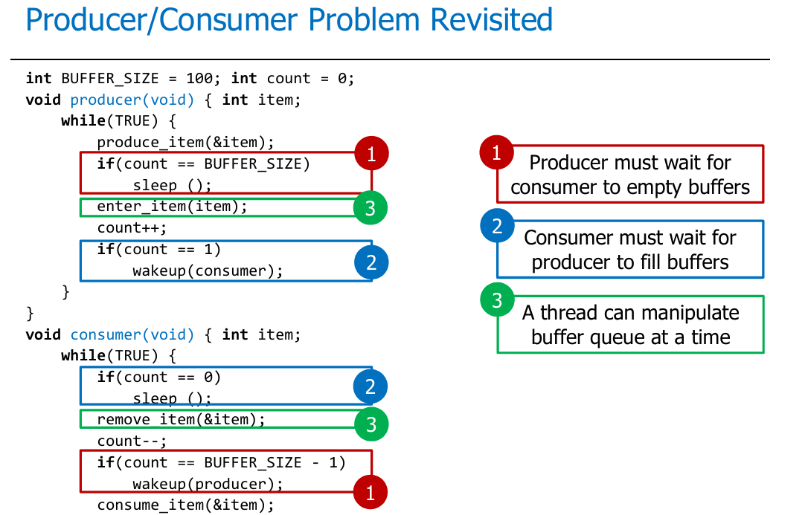

Slide 23
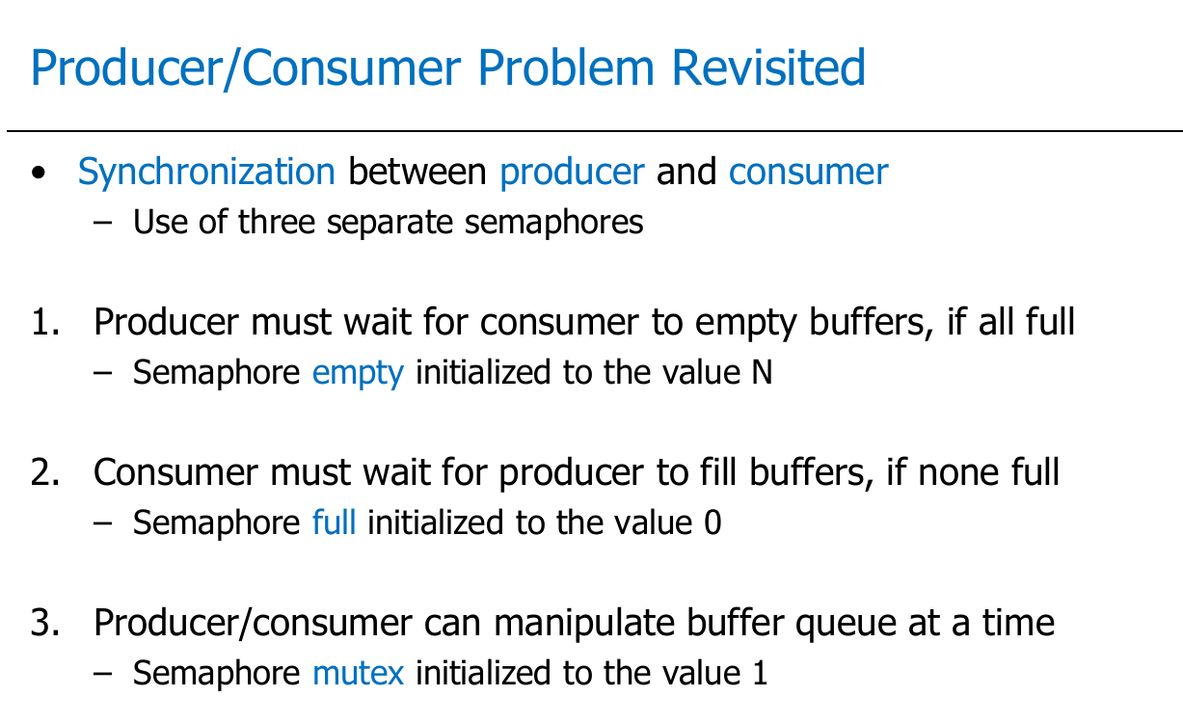

Slide 24
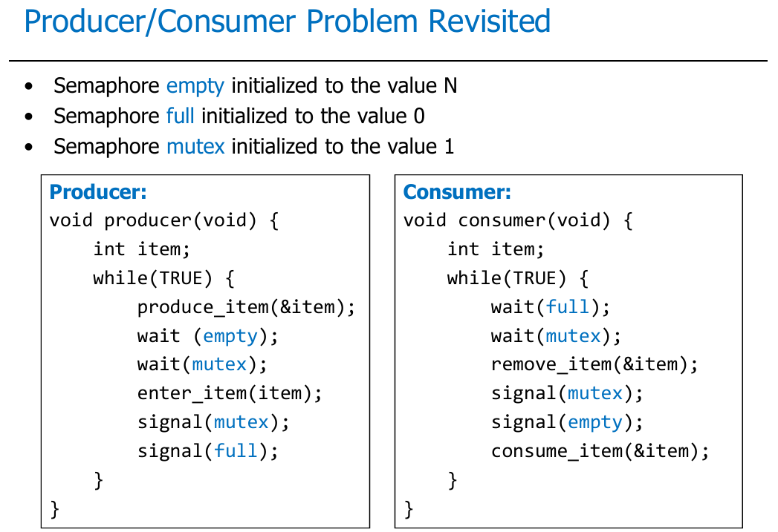

Slide 25
Semaphores - Limitations
One has to be really careful while working with the Semaphores
Problem with semaphores:
  Used for both mutex
  and scheduling constraints.
This makes the code hard to read, and hard to get right.
Possible scenarios of incorrect there would be a quiz in next class, scheduling constraint using semaphores, don’t tell all if you read usage
  signal (mutex) …. wait (mutex)
  wait (mutex) … wait (mutex)
  Omitting of wait (mutex) or signal (mutex) (or both)_x0010_

Slide 26
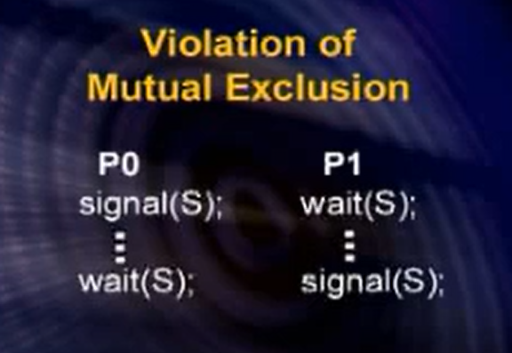
Bad use of semaphore

Slide 27
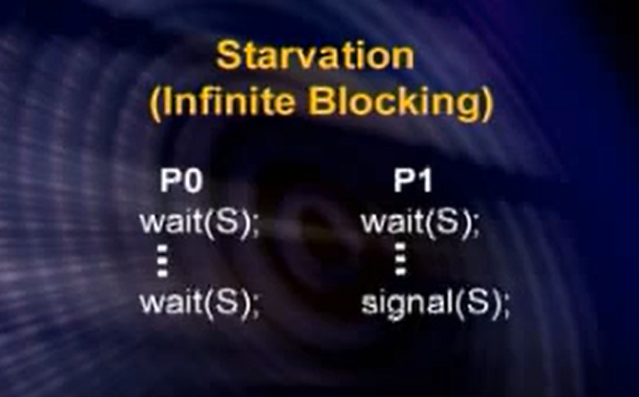
Bad use of Semaphore

Slide 28
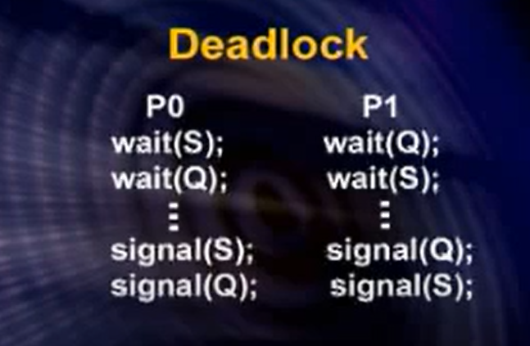
Bad Use of Semaphore

